Slide 1
SOME POTENTIAL TALKING POINT CHARTS
The Trifecta
Historically Narrow Breadth – Magnificent Seven
The Parabolic Rise
The Doomed Double Top – “M” Formation Pattern
The Warning Trigger Signals
Stealth Liquidity: Coordinated by Treasury & Fed in Two Stages
The “Game of Tightening” – Financial Conditions Index
GDP v GDI -1
GDP v GDI -2
GDP v GDI -3
GDP V Debt
The Illusion of Growth – Debt v GDP
The Yield Curve
No Longer the Fed PUT but rather the Treasury PUT!
The Coming Focus: Scarcity & Currencies
Collectivism v Complexity
High Volatility, Higher Inflation, Higher Rates and Higher Risk Premiums,
The Great Stagflation – The Beta Drought Decade,

Slide 2
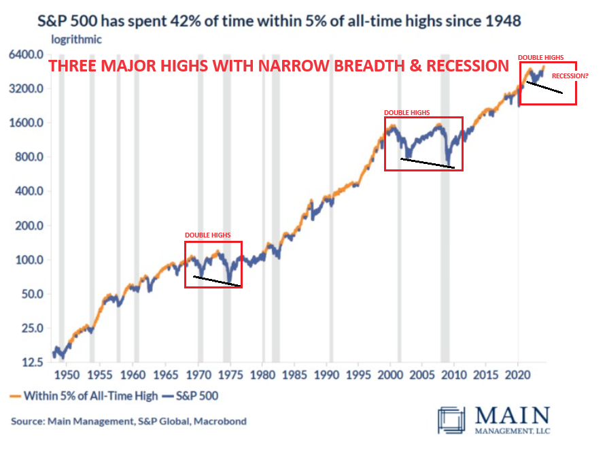
MATASII MACRO MAPS
THE TRIFECTA
1- EXTREME NARROW
BREADTH w/
PARABOLIC RISE
2- DOUBLE HIGHS
3- RECESSION
on 2nd HIGH

Slide 3
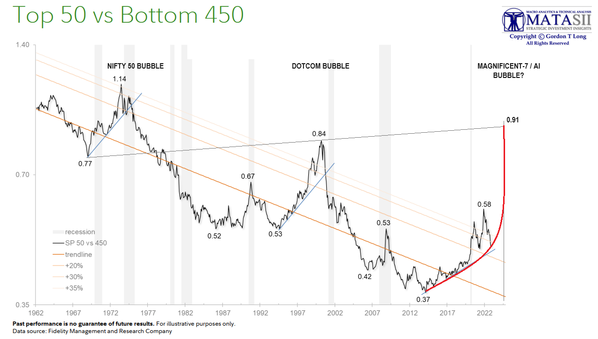
MATASII MACRO MAPS
Historically Narrow Breadth – Magnificent Seven

Slide 4
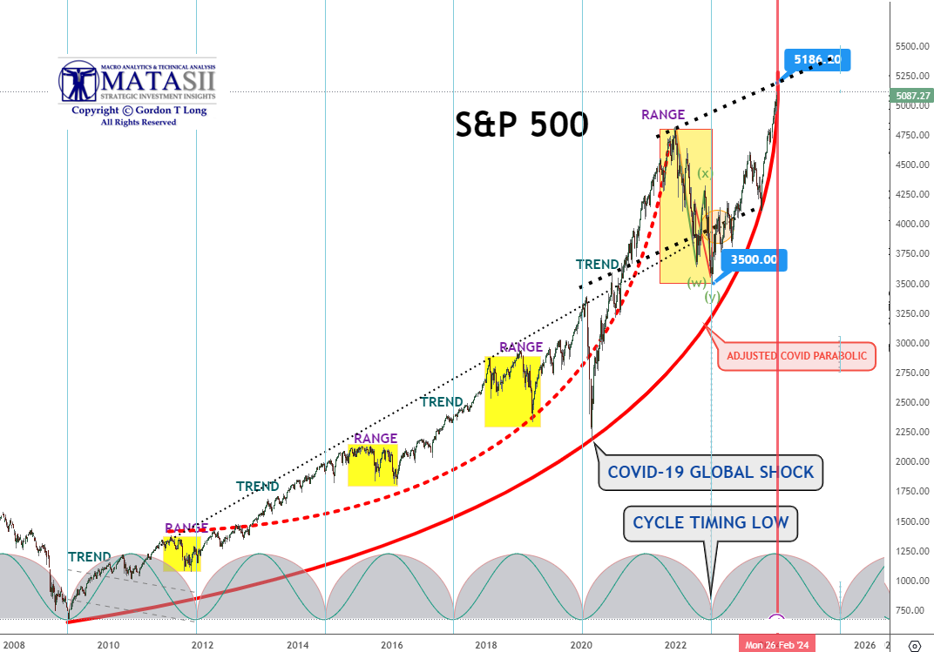
MATASII MACRO MAPS
Longer Term Parabolic Rise

Slide 5
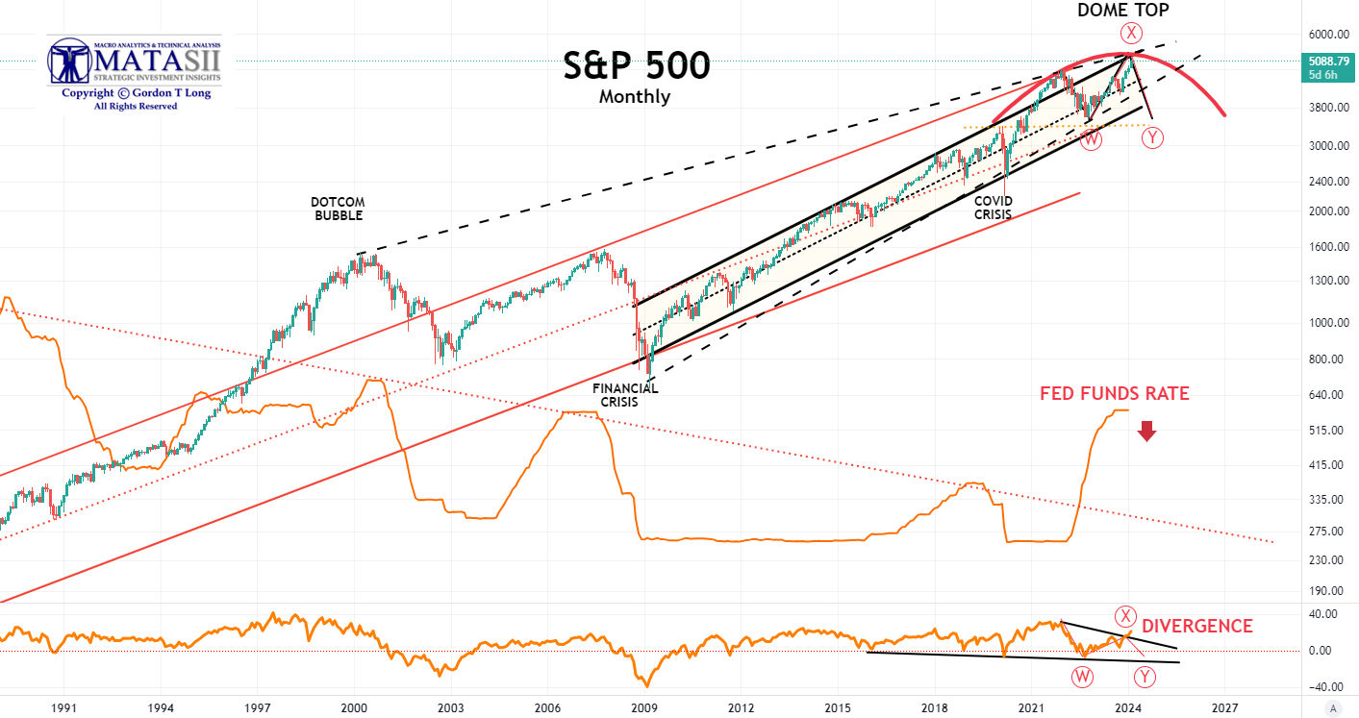
MATASII MACRO MAPS
The Doomed Double Top – “M” Formation

Slide 6
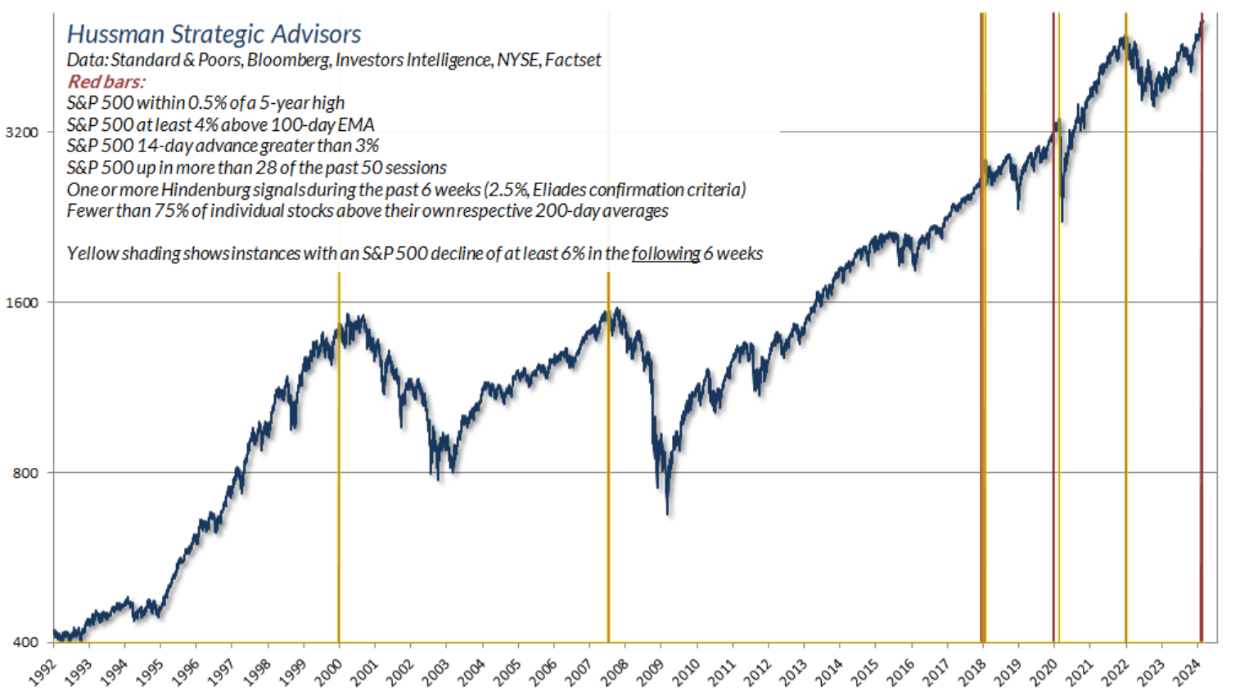
MATASII MACRO MAPS
Warning Trigger Points

Slide 7
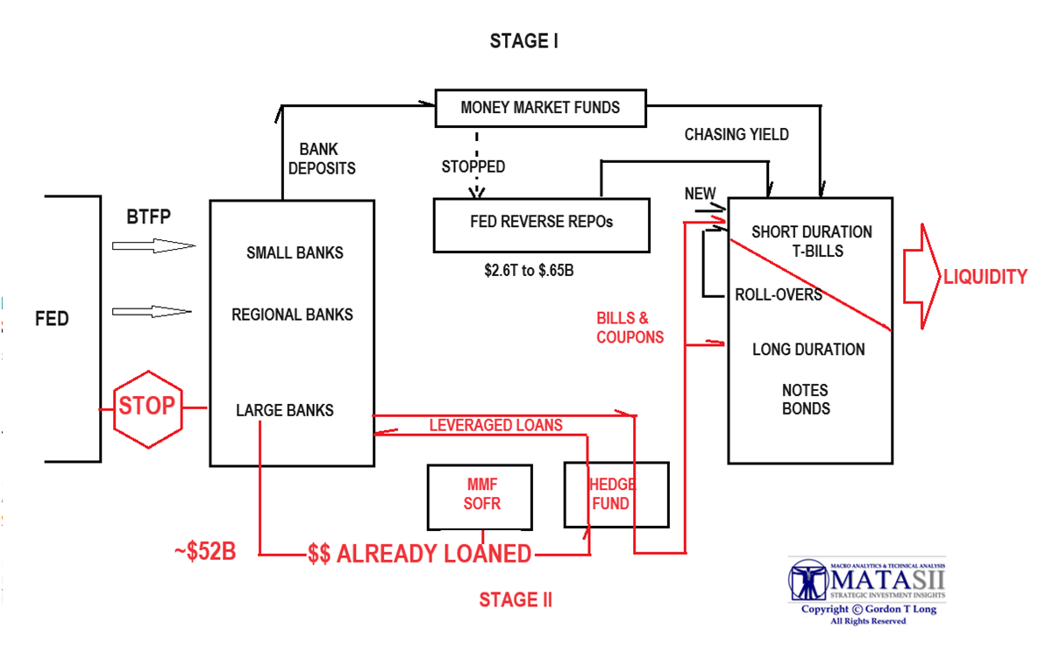
MATASII MACRO MAPS
STEALTH LIQUIDITY COORDINATED BY TREASURY & FED IN TWO STAGES

Slide 8
MATASII MACRO MAPS
The “Game of Tightening”

Slide 10
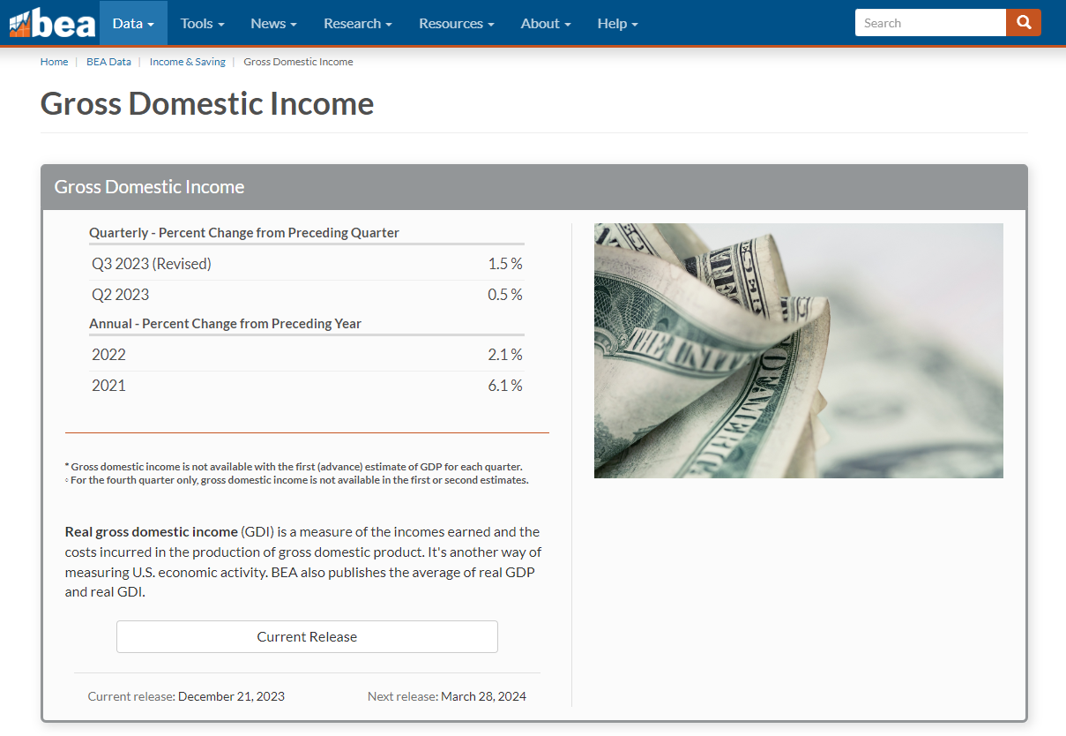
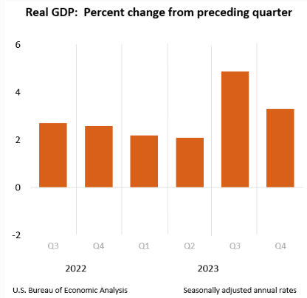
Gross Domestic Product
GDP
Q3 2023 5.0%
Q2 2023 3.0%
2022 9.2%
2021 10.1%

Slide 11
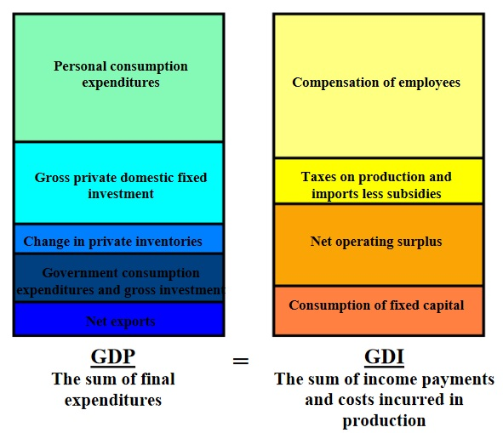
THE ILLUSION OF GROWTH BY DEBT
EXPENDITURES INCOMES
INCREASING AS CREDIT CARD USAGE
EXPLODES
HOUSING & CAR COSTS INCREASING
EXPLODING GOVERNMENT SPENDING
EXPANDING TRADE DEFICITS
FALLING ON A REAL BASIS
FALLING TAX REVENUES
ZOMBIE CORPORATIONS
FALLING CAPEX

Slide 12
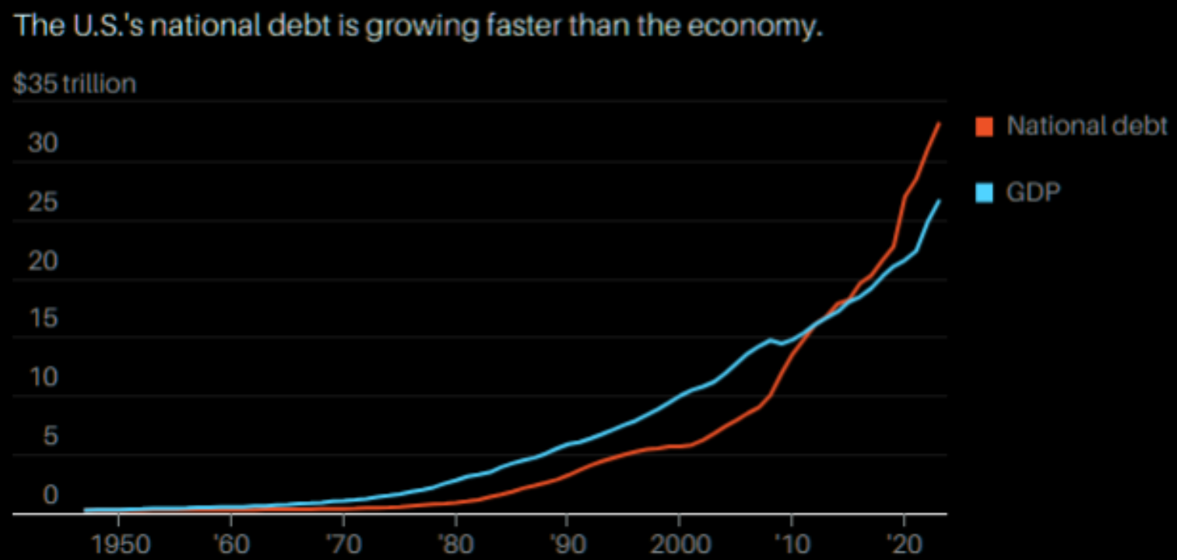
MATASII MACRO MAPS
GDP v GDI

Slide 13
MATASII MACRO MAPS
FLAWED FORMULA – BUILT FOR NON-CREDIT BALANCE OF PAYMENTS

Slide 14
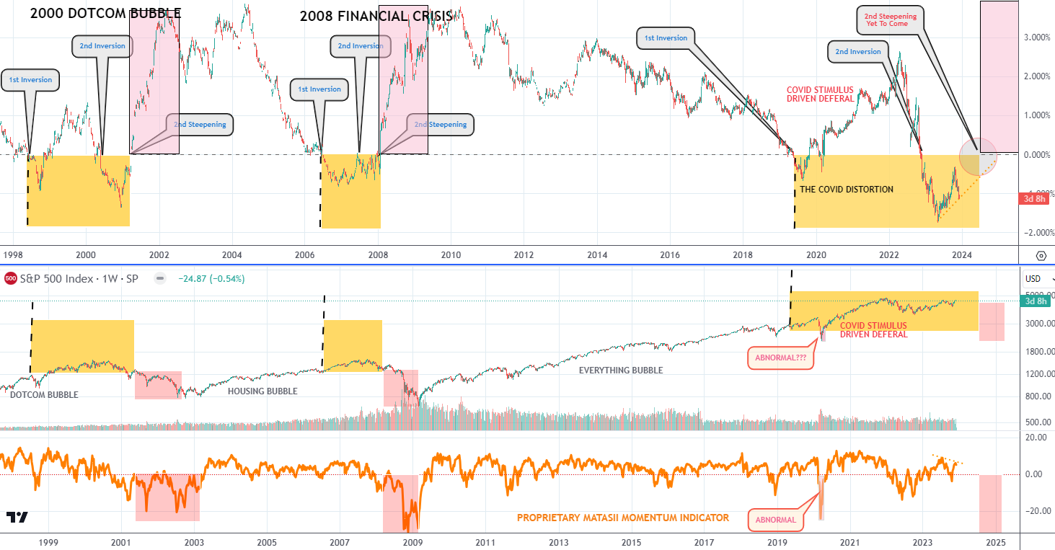
MATASII MACRO MAPS
The Yield Curve

Slide 15
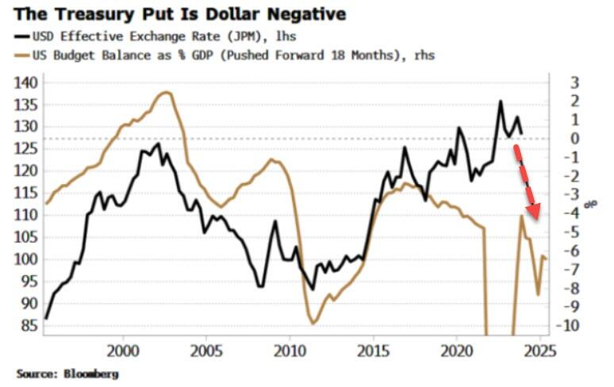
MATASII MACRO MAPS
No Longer the Fed PUT but rather the Treasury PUT!

Slide 16
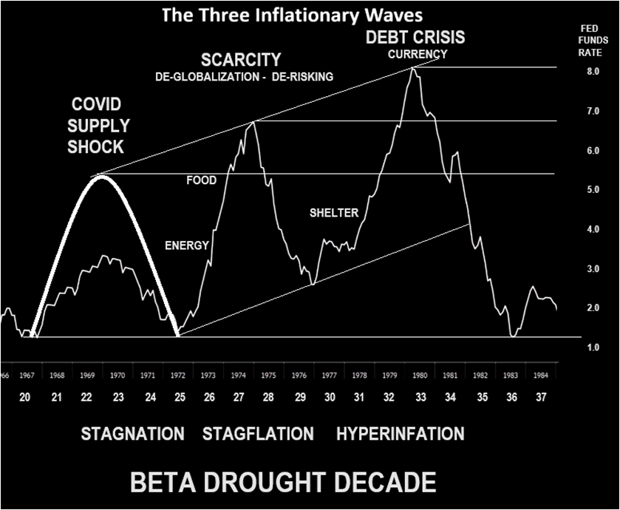
MATASII MACRO MAPS
THE COMING FOCUS: SCARCITY & CURRENCIES

Slide 17
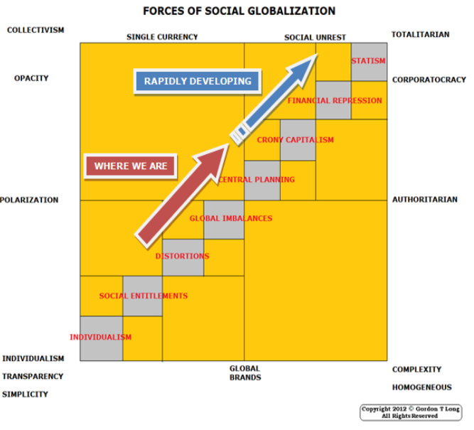
MATASII MACRO MAPS
COLLECTIVISM v COMPLEXITY

Slide 18
MATASII MACRO MAPS
THE GREAT MODERATION ENDS

Slide 19
MATASII MACRO MAPS
TITE

