Slide 1
GORDON T LONG
CO-FOUNDER TRIGGERS.CA

Slide 2
NOTE
Slides Are for discussion and educational purposes ONLY!
Do not Trade from Any of these Charts.
Gordon T Long is not giving investment advise nor should be construed as such
Always consult a professional investment advisor before making any investment decisions.
The content of this slide should not be considered investment advice of any sort, nor should it be used to make investment decisions. Use of this slide is considered to be your explicit acceptance of the Disclosure Statement and the Terms of Use found on the first and last frames of this video

Slide 3
INVESTMENT THEMES: 2025 Q2 UPDATE
“Expect the best. Prepare for the worst. Capitalize on what comes!”

Slide 4
AGENDA
MIRAN’S ROADMAP
CURRENCY DEVALUATION
FIRST TO DEVALUE WINS!
LESSONS FROM HISTORY
TRADE WARS BECOME CURRENCY WAR
WHO IS FIRST: CHINA OR THE US?
USDCNH
DXY
NON FIAT CURRENCIES
PRECIOUS METALS
BLACK GOLD
CRYPTO
CONCLUSIONS
4th TURNING BRINGS DRAMATIC & UNEXPECTED POLICY CHANGES

Slide 5
AGENDA
MIRAN’S ROADMAP
CURRENCY DEVALUATION
FIRST TO DEVALUE WINS!
LESSONS FROM HISTORY
TRADE WARS BECOME CURRENCY WAR
WHO IS FIRST: CHINA OR THE US?
USDCNH
DXY
NON FIAT CURRENCIES
PRECIOUS METALS
BLACK GOLD
CRYPTO
CONCLUSIONS
THE GREAT RESET
CHANGING THE GLOBAL TRADING SYSTEM

Slide 6
THE UNFOLDING ROADMAP
1- TARIFFs - A Destabilizing Shock
2- TARIFF NEGOTIATIONS - On a Unilateral Basis
3- A US TRADE BLOCK - A US Trade version of OPEC+
4- US DOLLAR DEVALUATION - Surging Gold is now "Front Running" This Stage

Slide 7
THE UNFOLDING ROADMAP
1- TARIFFs - A Destabilizing Shock
2- TARIFF NEGOTIATIONS - On a Unilateral Basis
3- A US TRADE BLOCK - A US Trade version of OPEC+
4- US DOLLAR DEVALUATION - Surging Gold is now "Front Running" This Stage
WE ARE
HERE

Slide 8
POINTS OF PIVOT
1- DOLLAR OVERVALUATION
The root of US economic imbalances lies in persistent dollar overvaluation that prevents the balancing of international trade, and this overvaluation is driven by inelastic demand for reserve assets.
As global GDP grows, it becomes increasingly burdensome for the United States to finance the provision of:
Reserve Assets and a
Defense Umbrella
.. since the manufacturing and tradable sectors bear the brunt of the costs.

Slide 9
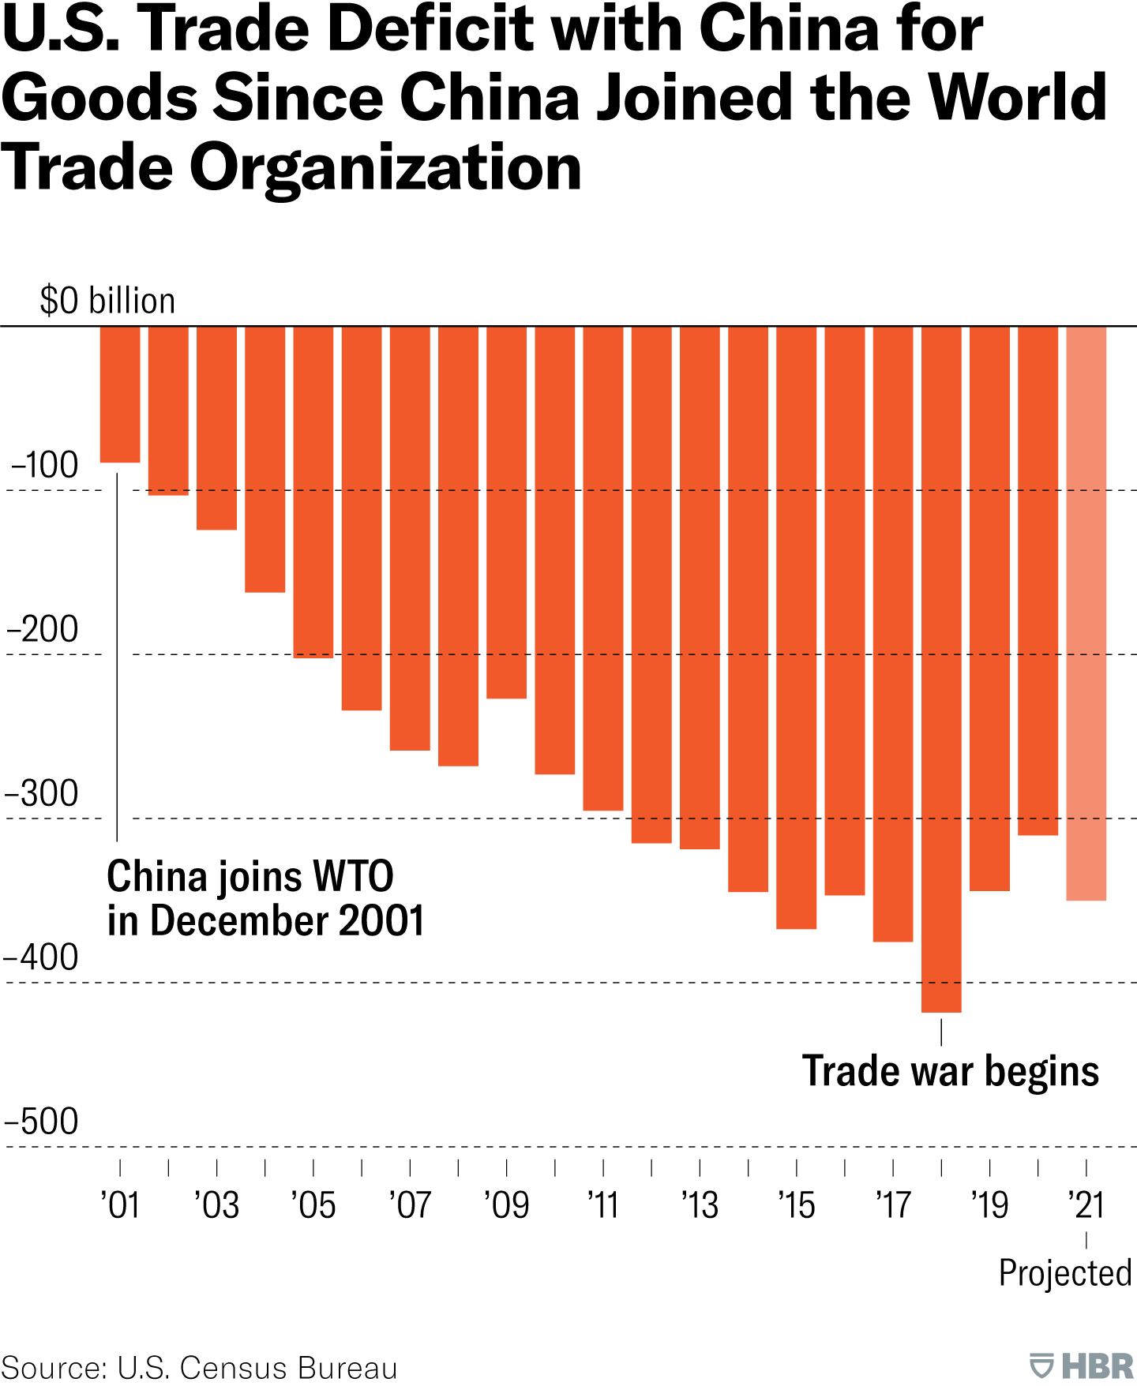
US BALANCE OF TRADE SINCE 2002

Slide 10
POINTS OF PIVOT
2- TARIFFS
Tariffs provide national revenue (which the US desperately needs) but more importantly:
If offset by currency adjustments, present minimal inflationary or otherwise adverse side effects, consistent with the experience in 2018-2019.
While currency offset can inhibit adjustments to trade flows, it suggests that:
Tariffs are ultimately financed by the tariffed nation, whose real purchasing power and wealth decline.
Revenue raised improves burden sharing for reserve asset provision.

Slide 11
POINTS OF PIVOT
3- NATIONAL SECURITY
Tariffs must be implemented in a manner deeply intertwined with national security concerns and in the context of the U.S. taxation system.
Currency policy aimed at correcting the undervaluation of other nations’ currencies brings an entirely different set of tradeoffs and potential implications.
Historically, the United States has pursued multilateral approaches to currency adjustments.
While many analysts believe there are no tools available to unilaterally address currency misvaluation, that is not true.
There are some potential avenues for both multilateral and unilateral currency adjustment strategies, as well as means of mitigating unwanted side effects

Slide 12
EXPECTATIONS
A much stronger demarcation between friend, foe and neutral trading partner.
Friends are inside the security and economic umbrella, but there is more burden sharing.
Based on the scope of that burden sharing, friends may experience more favorable trade or currency terms.
Those outside the security umbrella will also find themselves outside friendly arrangements for international trade and easy access to the U.S. consumer.
They will have more aggressive costs imposed on them via tariffs and other policies. There are obvious implications for asset prices.
The threat of withdrawal of the security umbrella without burden sharing will have its own, potentially volatile, consequences.

Slide 13
EXPECTATIONS
Will it spur nations around the world to invest more in defense?
Will it encourage more aggressive action by bad actors against those now outside the defense umbrella?
These are significant degrees of uncertainty which will permeate markets.
Risk premia may rise for assets in countries that now experience greater security risks.
A structural increase in implied volatility in currency markets.
The scope for monumental, once-every-few decades level of shifts in policy ought to significantly heighten expectations for volatility

Slide 14
EXPECTATIONS
These policies may supercharge efforts of those looking to minimize exposure to the United States. Efforts to find alternatives to the dollar and dollar assets will intensify. There remain significant structural challenges with internationalizing the renminbi or inventing any sort of “BRICS currency,” so any such efforts will likely continue to fail, but alternative reserve assets like gold or crypto-currencies will likely benefit.
Wall Street consensus that an Administration has no means by which to affect the foreign exchange value of the dollar, should it desire to do so, is wrong. Government has many means of doing so, both multilaterally and unilaterally. No matter what approach it takes, however, attention must be paid to steps to minimize volatility. Assistance from trading partners or the Federal Reserve can be helpful in doing so.

Slide 15
THE UNFOLDING ROADMAP
1- TARIFFs - A Destabilizing Shock
2- TARIFF NEGOTIATIONS - On a Unilateral Basis
3- A US TRADE BLOCK - A US Trade version of OPEC+
4- US DOLLAR DEVALUATION - Surging Gold is now "Front Running" This Stage
WE ARE
HERE
CURRENCY
TOOLS

Slide 16
AGENDA
MIRAN’S ROADMAP
CURRENCY DEVALUATION
FIRST TO DEVALUE WINS!
LESSONS FROM HISTORY
TRADE WARS BECOME CURRENCY WAR
WHO IS FIRST: CHINA OR THE US?
USDCNH
DXY
NON FIAT CURRENCIES
PRECIOUS METALS
BLACK GOLD
CRYPTO
CONCLUSIONS
THE GREAT RESET
CHANGING THE GLOBAL TRADING SYSTEM

Slide 17
As Ben Bernanke told Milton Friedman on his ninetieth birthday:
"The countries that remained on gold suffered much more severe contractions in output and prices than the countries leaving gold... countries that left gold earlier also recovered earlier."
In other words …. those that devalued first won!

Slide 18
Treasury Secretary Scott Bessent understands the implications:
"China is the surplus country. Their exports to the US are five times our exports to China. So, they can raise their tariffs .... but, so what?“
If China cannot find markets to absorb its overcapacity, it will face its own great depression, made worse from its demographic disaster, and perhaps be forced into war to distract the populace.
There are risks for the US as well, and not just war with China.

Slide 19
RISKS
Foreigners buy Treasury bonds with dollars they accumulate from trade surpluses.
If Trump balances trade, or even reduces the trade deficit, there will be correspondingly less external demand for Treasuries.
The tariffs, therefore, are called upon to serve a dual purpose of balancing trade and raising revenue.

Slide 20
PROBLEMS
Cutting spending through DOGE or any other means becomes a necessity.
A falling stock market also serves Trump's strategy by reducing the wealth effect and, therefore, inflation, which might prompt the Fed to act.
Falling stock market also pushes scared money into the bond market, lowering interest rates. Note, however, that in a gold standard, rates rise to attract capital and allocate it to more productive enterprises.

Slide 21
To achieve his goals, Trump will need to recreate that effect through political direction of capital.
Trump is knocking down the post-World War II geopolitical structures because they no longer serve America's interests. Even assuming his economic plan succeeds, the value of all currencies will be substantially lower. China is already devaluing the Yuan.
One misplaced step could turn a controlled demolition into a panic unwind of the entire global credit bubble.
A central bank bailout would have to be on a scale larger even than COVID. And central bank balance sheets are so weak, there is no guarantee that the next intervention will be successful, in which case bonds, stocks, and currencies all collapse in tandem, as has occurred over the years in many an emerging market.

Slide 22
Productivity exploded off of a foundation when truth and individual sovereignty created free markets and innovation by design, first within then among nations.
Progress is not steady, however, and many eras have seen decades or even centuries of retrogression. The abandonment of the international gold standard and adoption of politically managed currencies subtly reintroduced mercantilism, a predatory regime under which trade creates winners and losers.
Trump understands that America as a whole has been the loser.
Trump is determined to make America the winner. The best outcome, however, assuming the world can avoid the horrors of a global war, would be a collapse of currencies and a natural return to the gold standard and market-enforced balanced trade.

Slide 23
SOMETHING TO THINK ABOUT
At $3,200/ oz, gold represents 12.4% of the Fed's assets, which is below the 12.9% reading recorded at the end of 1971, when gold traded at $37.40/oz.
It is still cheap in U.S. terms. Non-U.S. institutions in particular are figuring out that gold, with a total market value of $22.4 trillion, is one of few asset classes able to absorb safe-haven /lows and provide diversification away from Treasury bonds.
As gold reenters the global financial system as the preeminent international reserve asset, the only entities able to do QE will be the gold miners.

Slide 24
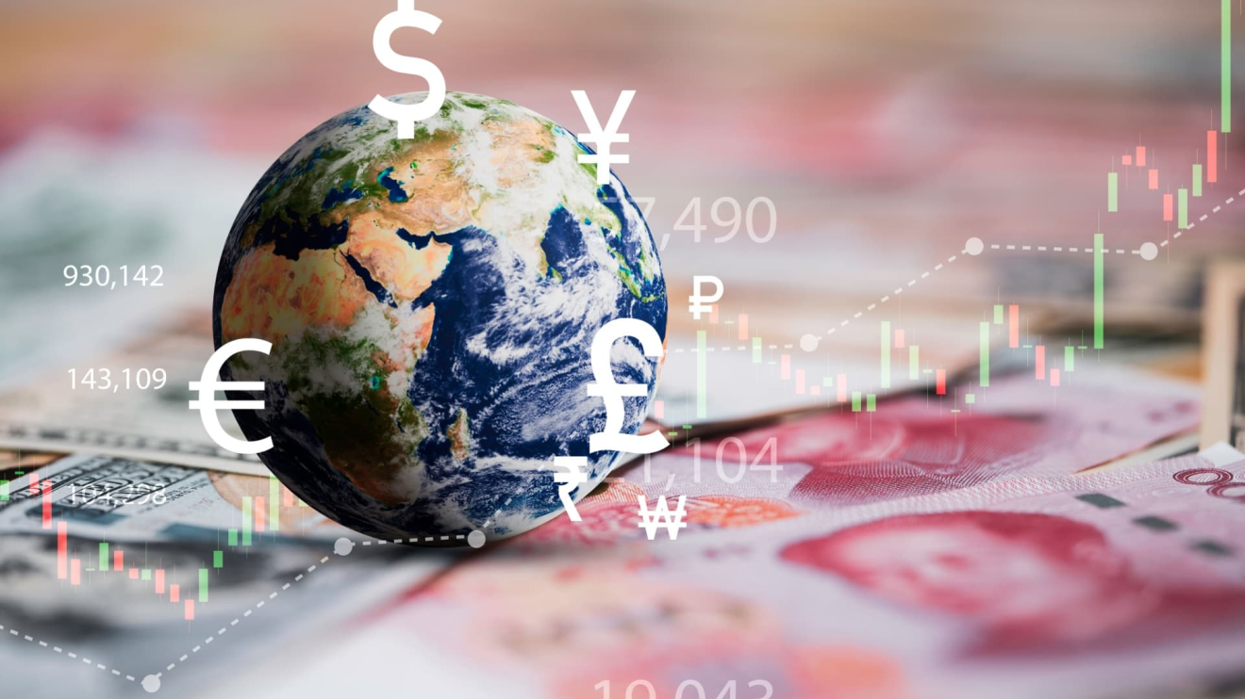
AGENDA
MIRAN’S ROADMAP
CURRENCY DEVALUATION
FIRST TO DEVALUE WINS!
LESSONS FROM HISTORY
TRADE WARS BECOME CURRENCY WAR
WHO IS FIRST: CHINA OR THE US?
USDCNH
DXY
NON FIAT CURRENCIES
PRECIOUS METALS
BLACK GOLD
CRYPTO
CONCLUSIONS
THE GREAT RESET
CHANGING THE GLOBAL TRADING SYSTEM

Slide 25
WHO IS FIRST: CHINA OR THE US?
When will Beijing devalue the yuan — and by how much — is a matter of great concern.
Its actions could ignite a global currency war and exacerbate fears of capital outflow from emerging markets.
The People’s Bank of China is signaling a willingness to weaken the RMB, but on its own terms. Currently the central bank sets its daily reference rate at above 7.20 per dollar, a psychologically important level that had not been breached since September 2023, even as the greenback fell against other major currencies.
Meanwhile, the PBOC has asked state banks to reduce dollar purchases to avoid steep declines in the Yuan.

Slide 26
WHO IS FIRST: CHINA OR THE US?
One way to think about China’s currency policy is its fiscal stance. Unless Beijing brings out the stimulus bazooka, devaluing the Yuan might be the most expedient option to avert further economic downturn.
Trump’s punitive tariffs will hurt. In the December quarter, net exports contributed to 46% of China’s total economic expansion. As a result of this trade shock, the economy might grow by only 2% this year, the lowest since late 1970s, according to Barclays PLC.
For now, Yuan traders can likely expect some calm. That no major stimulus has been announced doesn’t mean it won’t come. After all, it takes time to put together a big package. To hit the 5% growth target, Beijing will need to roll out another 12 trillion Chinese yuan ($1.6 trillion), or 8.6% of gross domestic product, the bank reckons. At the National People’s Congress in March, China already raised its broad budget deficit to 8% of GDP, versus 6.6% last year. In recent weeks, top officials have said the government has ample room for more fiscal easing.

Slide 27
WHO IS FIRST: CHINA OR THE US?
This tranquility may be broken, however, if China can’t come up with a concrete fiscal figure by the Politburo meeting in July, when top politicians set out economic priorities for the rest of the year. Monetary tools may have to be deployed instead. In this case, the Yuan might trend toward 9 per dollar from the current 7.3 to offset Trump’s tariffs, estimates Barclays.
While Barclays’s 20% downside sounds alarming, intuitively, it makes sense. The RMB weakened as much as 10% in 2018, when the U.S. raised its average tariff rate by less than 20%. Now, Chinese exporters on average face 135% levies. The yuan is roughly flat against the greenback this year.

Slide 28
WHO IS FIRST: CHINA OR THE US?
To be sure, economists are making various assumptions to reach their price targets. Barclays, for instance, assumes a fiscal multiplier of 0.3, so every percentage point increase in budget deficit gives only 0.3% boost to growth. Morgan Stanley, on the other hand, is more generous, seeing a 0.5% lift. What they do agree on, however, is that Beijing will stick to its growth target, one way or another.
Calling Trump’s tariff escalations a "joke,” China has vowed to "fight to the end.” That means every tool is on the table, including the currency.
Be prepare!

Slide 29
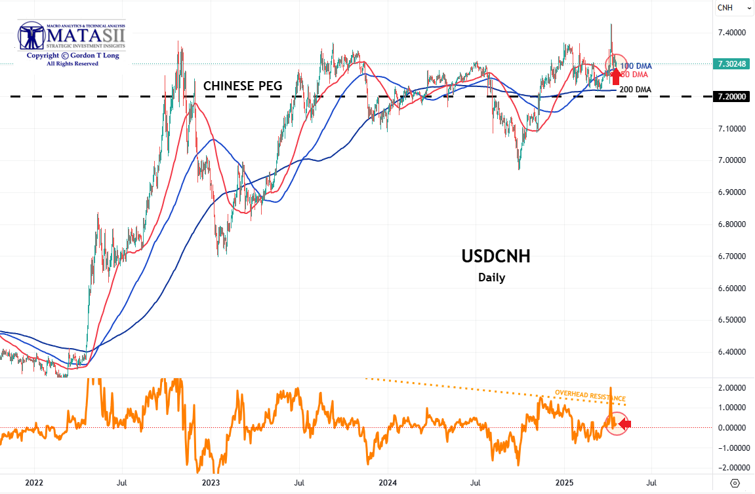
7.2

Slide 30
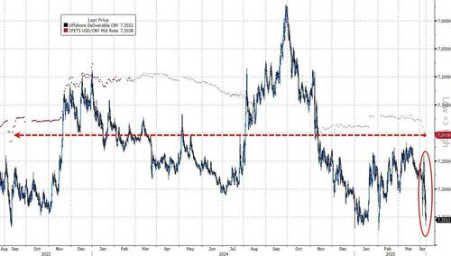
CHINA - USDCNH
Implied volatilities are climbing, but haven’t yet reached the levels seen just before the US elections in November, which suggests traders have room to build USD/CNH exposure. Indeed, the volatility curve looks set to go inverted which is a signal that extreme currency moves are expected.
Of course, China hinting at devaluation is a huge risk: China has $60 trillion in deposits, 3x more than the US. If this capital starts to flee, it will have catastrophic consequences. In 2015/16 we saw this, and it started the great move in bitcoin from $200 to $20,000
The PBOC Yuan fixing was above 7.2/USD for the first time since September 2023.

Slide 32
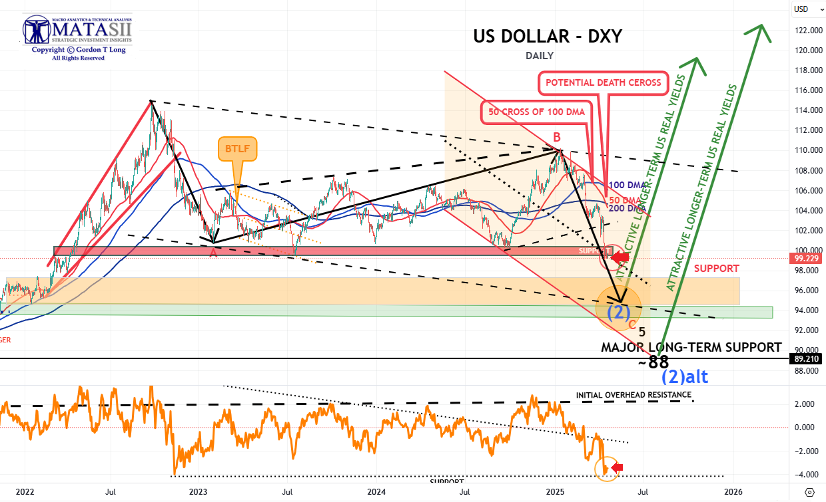

Slide 33
AGENDA
MIRAN’S ROADMAP
CURRENCY DEVALUATION
FIRST TO DEVALUE WINS!
LESSONS FROM HISTORY
TRADE WARS BECOME CURRENCY WAR
WHO IS FIRST: CHINA OR THE US?
USDCNH
DXY
NON FIAT CURRENCIES
PRECIOUS METALS
BLACK GOLD
CRYPTO
CONCLUSIONS
THE GREAT RESET
CHANGING THE GLOBAL TRADING SYSTEM

Slide 34
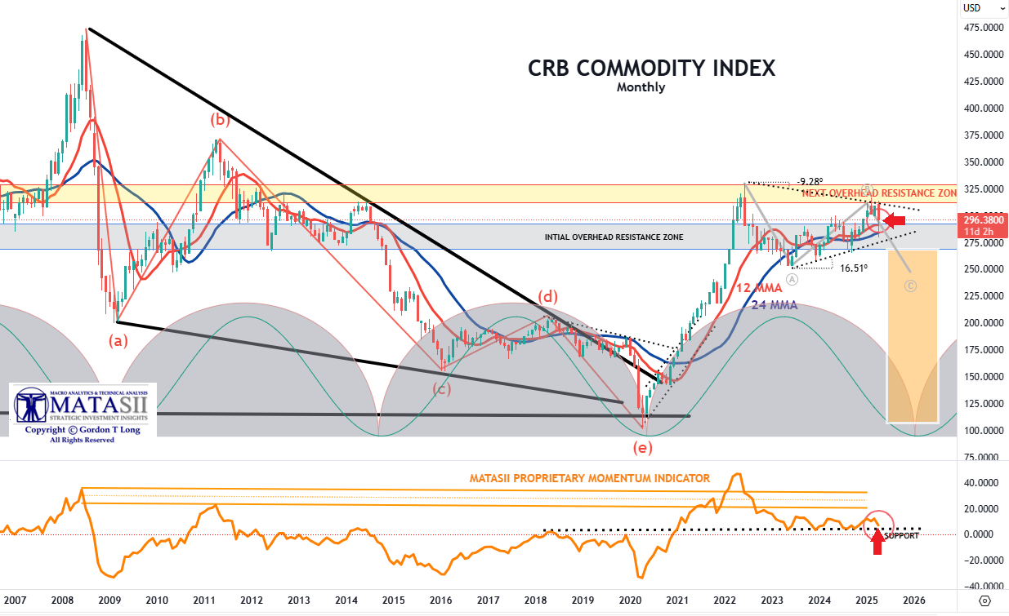

Slide 35
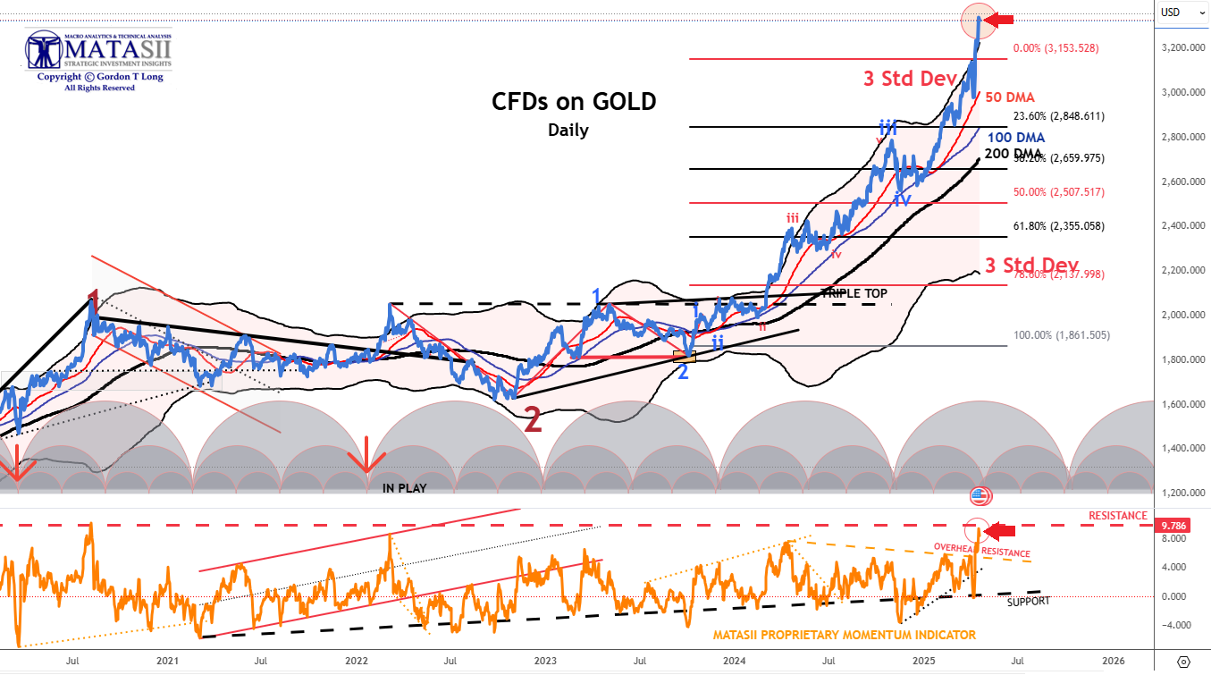

Slide 36
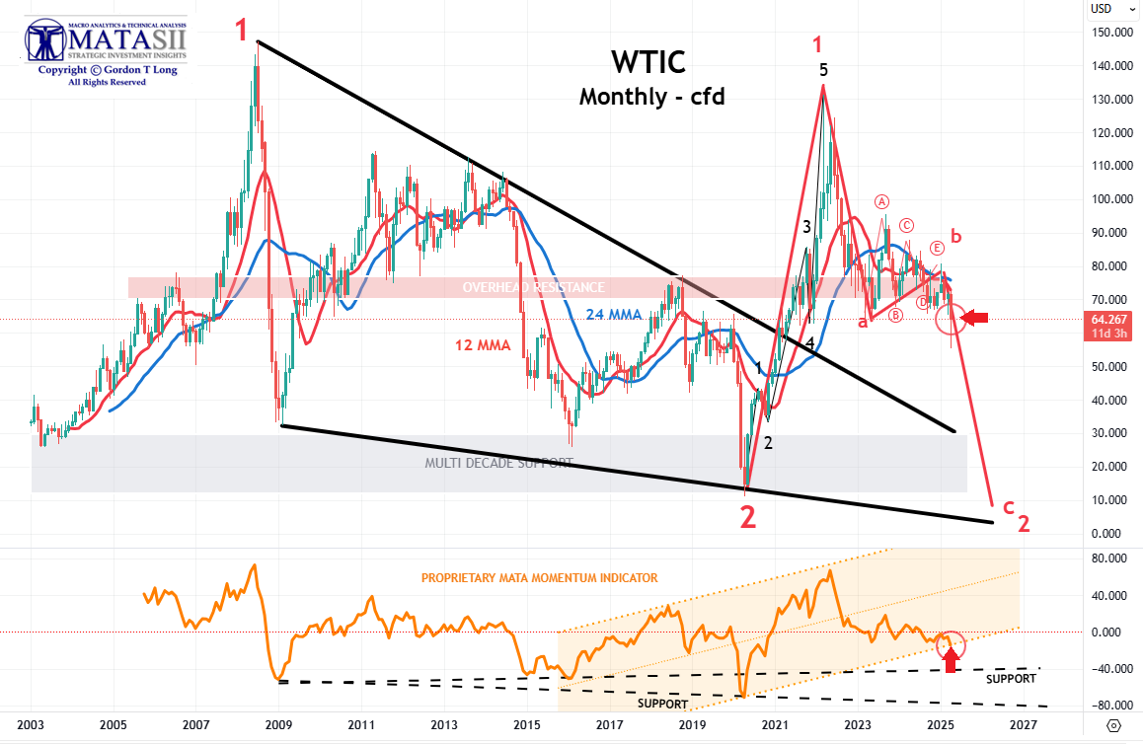

Slide 37
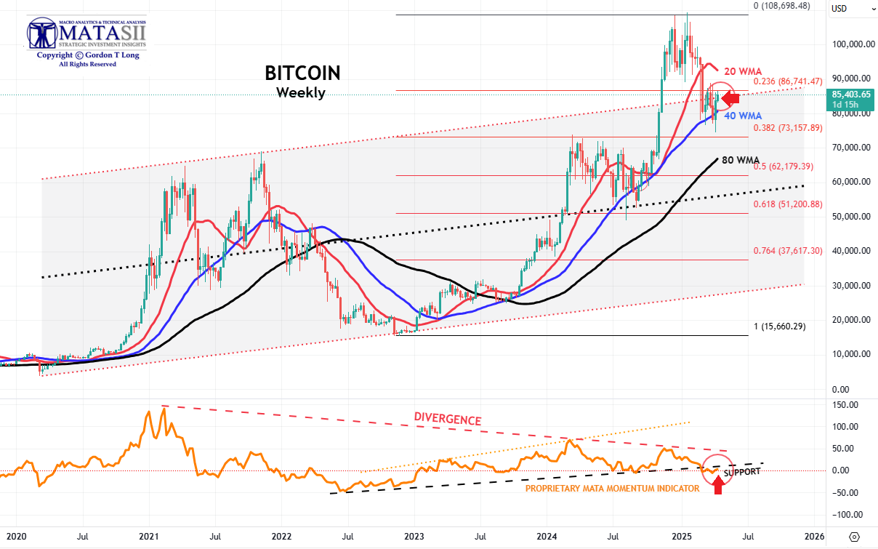

Slide 38
AGENDA
MIRAN’S ROADMAP
CURRENCY DEVALUATION
FIRST TO DEVALUE WINS!
LESSONS FROM HISTORY
TRADE WARS BECOME CURRENCY WAR
WHO IS FIRST: CHINA OR THE US?
USDCNH
DXY
NON FIAT CURRENCIES
PRECIOUS METALS
BLACK GOLD
CRYPTO
CONCLUSIONS
THE GREAT RESET
CHANGING THE GLOBAL TRADING SYSTEM

Slide 39
THE UNFOLDING ROADMAP
1- TARIFFs - A Destabilizing Shock
2- TARIFF NEGOTIATIONS - On a Unilateral Basis
3- A US TRADE BLOCK - A US Trade version of OPEC+
4- US DOLLAR DEVALUATION - Surging Gold is now "Front Running" This Stage
WE ARE
HERE
CURRENCY
TOOLS

Slide 40
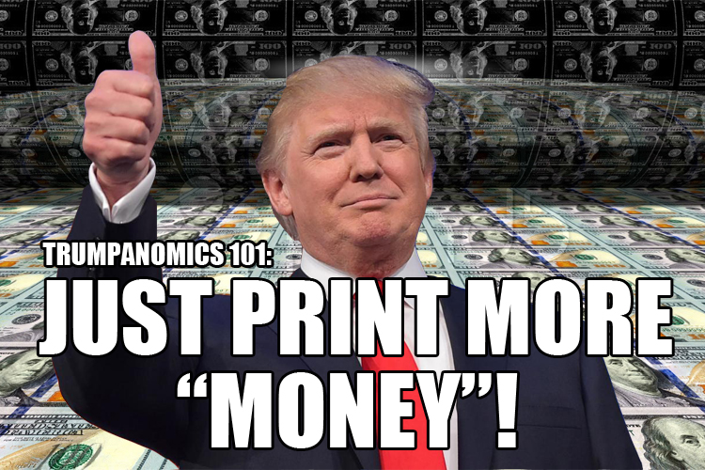
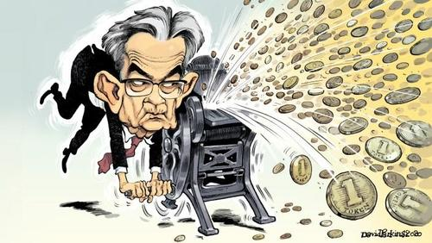
ADMINISTRATIONS CHANGE – BUT THE PRINTING NEVER DOES ….
DON’T WORRY, THEY WILL PRINT THE MONEY!
EVERYONE IS NOW IN PLACE & READY!!

Slide 41
NOTE
Slides Are for discussion and educational purposes ONLY!
Do not Trade from Any of these Charts.
Gordon T Long is not giving investment advise nor should be construed as such
Always consult a professional investment advisor before making any investment decisions.
The content of this slide should not be considered investment advice of any sort, nor should it be used to make investment decisions. Use of this slide is considered to be your explicit acceptance of the Disclosure Statement and the Terms of Use found on the first and last frames of this video

Slide 42
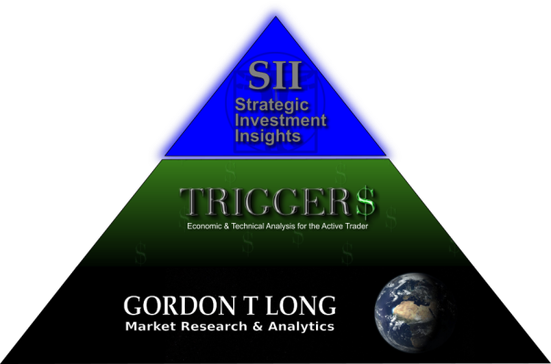
JOIN US AT MATASII.COM
FOR MORE ON THIS TOPIC & MANY OTHERS
Market Research
Technical Analysis
Strategic Investment Insights
Macro Analytics
Videos
Tipping Points
Synthesis & Analysis
Watch Lists
Real Time Charting
Guest Interviews
News Abstraction Process
Feature Articles

Slide 43
WE WELCOME YOUR COMMENTS!
WE READ ALL COMMENTS FOR FEEDBACK THAT WILL IMPROVE OUR RESEARCH ANALYSIS
WORLD CLASS MINDS FOLLOW THIS CHANNEL & WE VALUE HEARING FROM YOU!
IT IS THE ONLY PAYMENT WE ACCEPT FOR POSTING THIS FREE YOUTUBE CONTENT

